Slide 1
Emotion Analyzer To predict emotions of textual input

Slide 2
Why do we need Emotion Analyzer?
If we publish a product to customers, and we need to check, do customers liked our product or not?
For that we would collect feedback from the customers about the product. But we need to analyze all those feedbacks manually.
Even though, if we pick up few random feedback and try to predict users’ happiness, how we can say that we would get right result?
Even we use many other analyzers, we would get only positive or negative polarity of the feedbacks. We won’t get actual emotions and happiness factor from those analyzers.
To resolve all those type of issues, our system is pretty much useful.

Slide 3
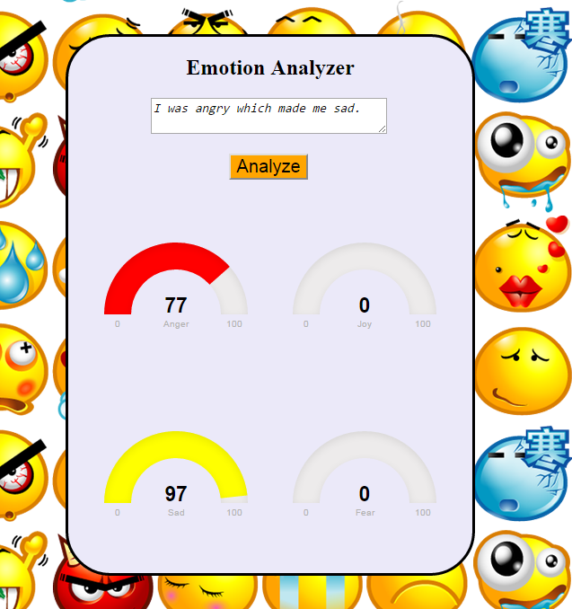
Text-based Emotion Analyzer
When you give feedback, our system will give you response as which emotion is present out of sad, anger, fear or joy along with percentage value in it.

Slide 4
How it works ?
This is a Classification problem as we need to classify sentence into 4 categories : joy, anger, sad, fear
Inputs:
Input in form of words, sentences, textual smileys or paragraphs.
Our system treat this data as raw input.
By applying PoS tagging, we will get our actual input data.
Algorithm:
We have developed a dictionary of words which contains words, impact score and emotions.
Impact score : weight of the word over sentence
Few rules are designed and applied to analyze the sentence more deeply.
Final score value is calculated for each sentences and then classified into 4 categories sad, anger, joy and fear.
From classified data, our system will generate graphical output.

Slide 5
How Emotion analysis is done ?
Being supervised learning we know the emotions for words e.g. We know emotions for the words in dictionary when we got words which are not present in dictionary, we will train our system for those situations.
Joy
Sad
Anger
Fear

Slide 6
Limitations
Fails in case where words are of different meanings in different situations.
Limited scope, works in very restricted and supervised conditions.
Fails in case where words are not found in bag of words.
Fails in case of phrases and idioms.

